Slide 1
The Right Cause
Waste Food Management And Donation System

Slide 2
Members
Pratiksha Angad Gore
Roll No:71257
Leena Laxman Zende
Roll No:71251
Parth Dilip Mahadik
Roll No:71253

Slide 3

Introduction
This project is used to manage wastage foods in a useful way. Every day the people are wasting lots of foods. So, we have to reduce that food wastage problem through online. If anyone have wastage foods, they are entering their food quantity details and their address in that application and then the admin maintains the details of food donator.

Slide 4
Need For A System
And the admin also maintains the buyer (orphanage, poor people,) details too. After the admin view the donator request and give the alert message like time to come and collect the food.
The admin collects foods from donator through their nearby agent then provide to nearest orphanages or poor people. After receiving the food from the agent by admin and give alert message to that donator. If the donator needs any detail about the orphanage with helping thought they can give request to the admin and collect the orphanage details.

Slide 5

This project is food redistribution is an enormously successful social innovation that tackles food waste and food poverty. The user’s details are maintained confidential because it maintains a separate account for each user.

Slide 6
Benefits Of Project
Benefits will be both the restaurant (reducing food wastage), and the needy
Keep track of wastage food for restaurant
User can play role in saving food wastage and help the needy

Slide 7
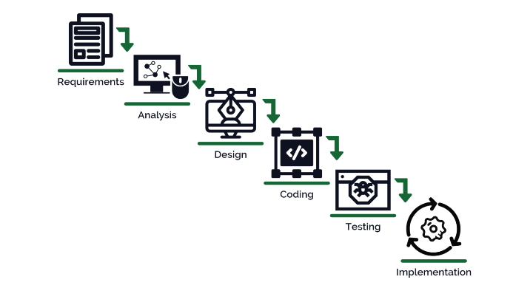
WaterFall Model

Slide 8
Hardware Requirement
Processor :64-bit, four-core, 2.5 GHz minimum per core
RAM :24 GB for developer and evaluation use
Hard disk :80 GB for installation For production use, you need additional free disk space for day- to-day operations. Add two times as much free space as you have RAM for production environments.

Slide 9
Software Requirement
Operating System : Windows
Web Technologies : Html, CSS
IDE : Notepad
Web Server : Microsoft Internet Explorer, Mozilla, Google Chrome or later
Operating System : Windows 10 / Windows 11
MS Word 97 or later

Slide 10
Thank You:)

